Slide 1
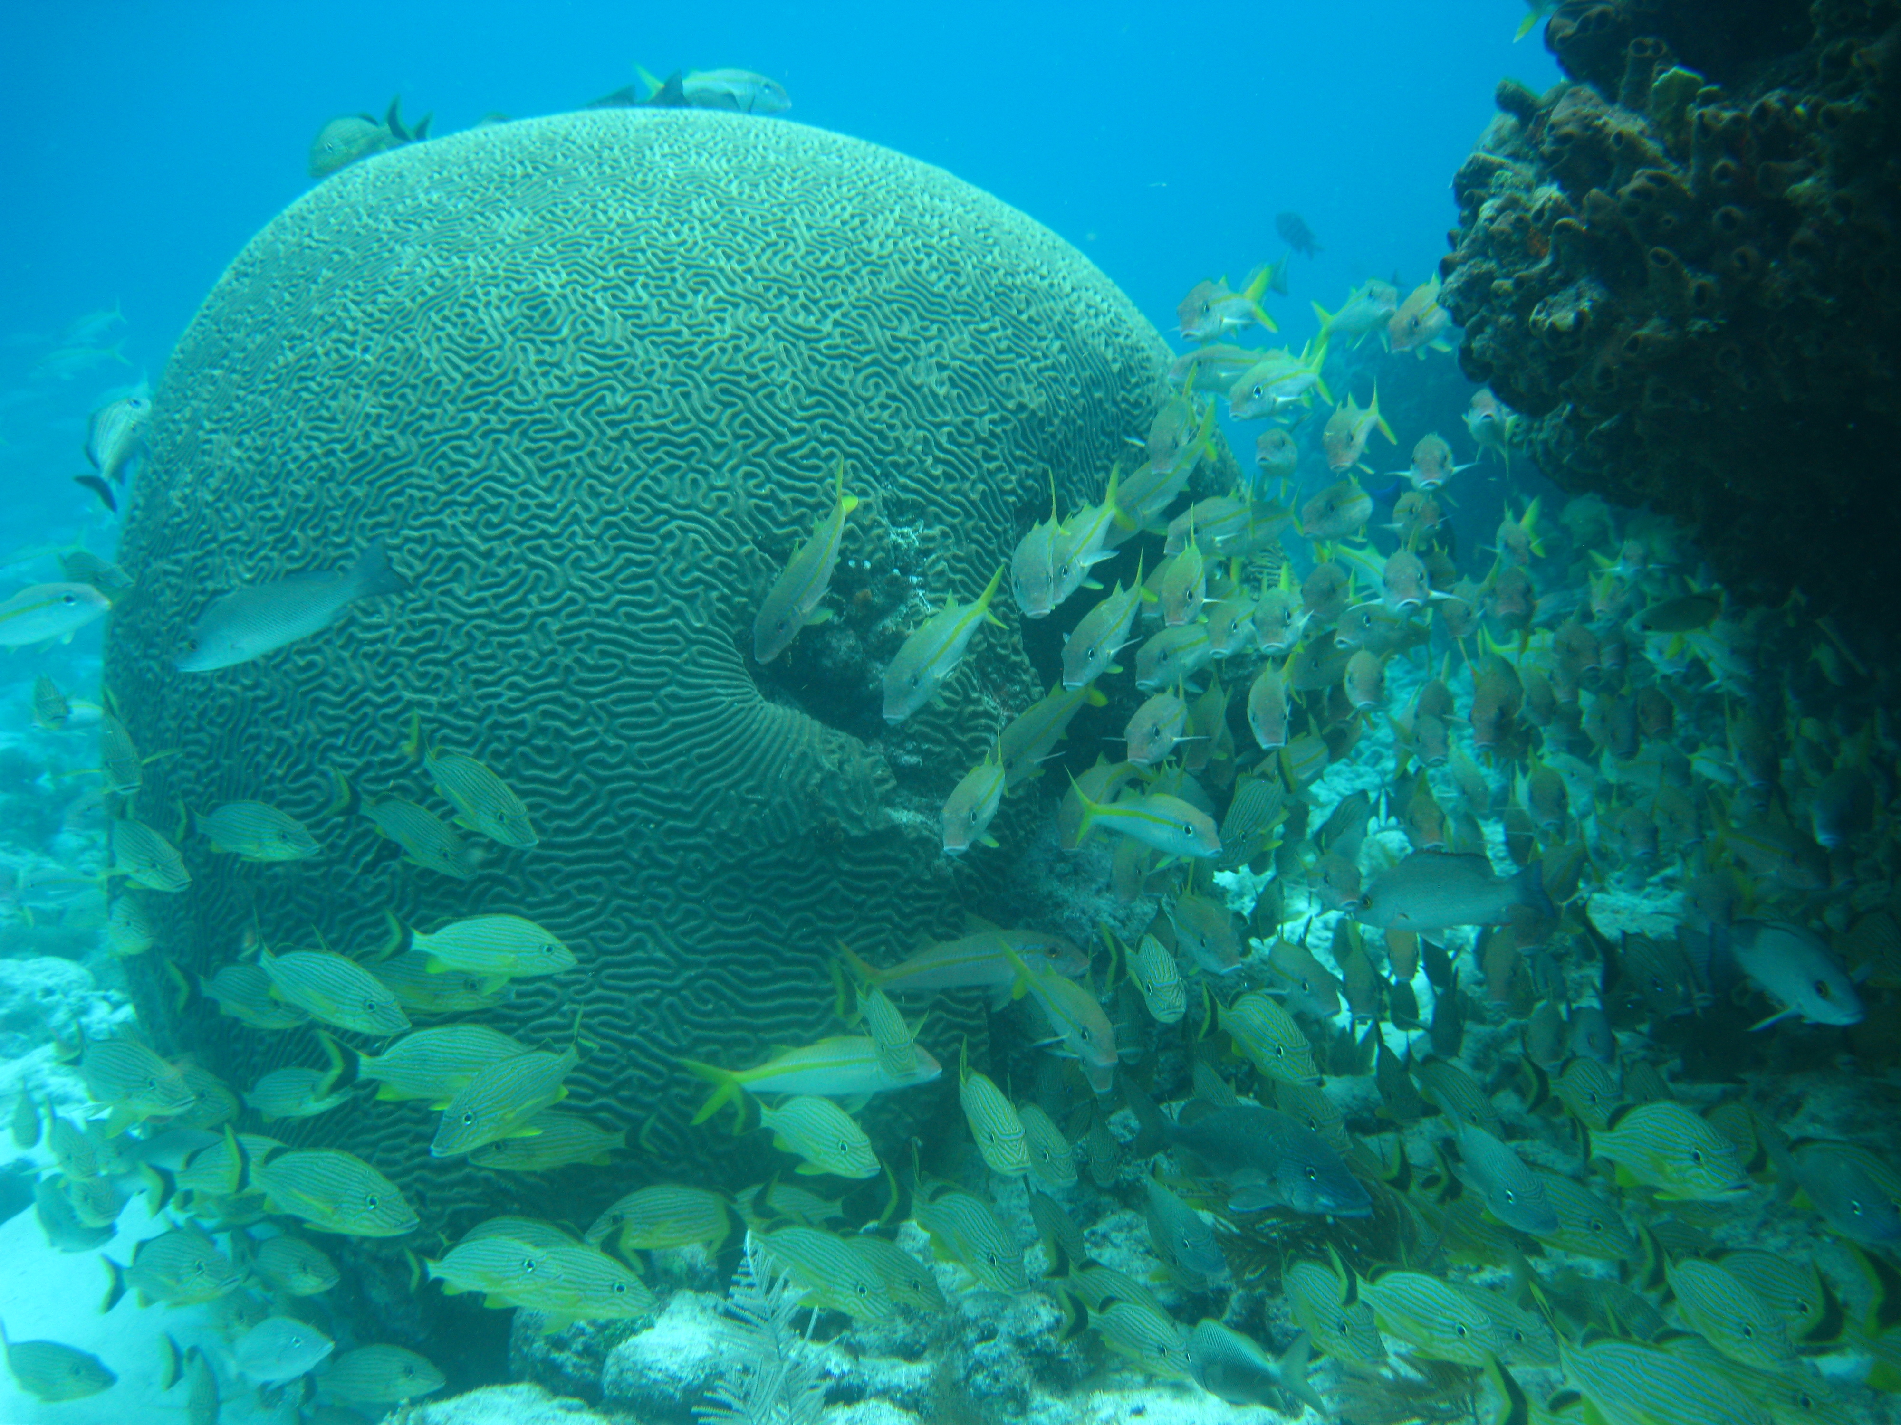
Nutrient supply from fishes impacts phase shifts in a Caribbean coral reef ecosystem
Deron E. Burkepile, Jacob Allgeier, Andrew Shantz, Catharine Pritchard, Nathan Lemoine, Laura Bhatti, James Heffernan, and Craig Layman
Florida International University
Email: deron.burkepile@fiu.edu
International Coral Reef Symposium
July 9, 2012
Notes:
Thanks Mike and thank you for inviting me to Florida International. I’ve enjoyed seeing FIU and meeting many of you and look forward to more of the faculty and students.

Slide 2
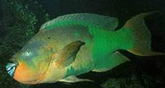
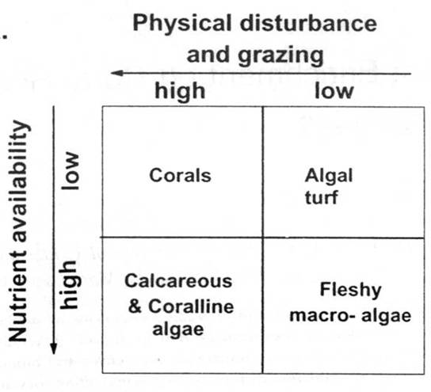
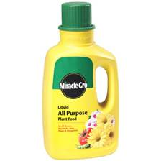
Top-down vs. Bottom-up Effects on Coral Reef Communities
Littler and Littler 1984
Notes:
Coral reefs are thought to exist on a continuum of top-down pressure from herbivores and bottom-up influence from nutrient availability. Corals will dominate when intense herbivory and low nutrient availability keep macroalgae low but macroalgae will dominate when herbivory is low and nutrient availability is high. Thus its important to test for the individual and synergistic effects of herbivores and nutrient availability.

Slide 3
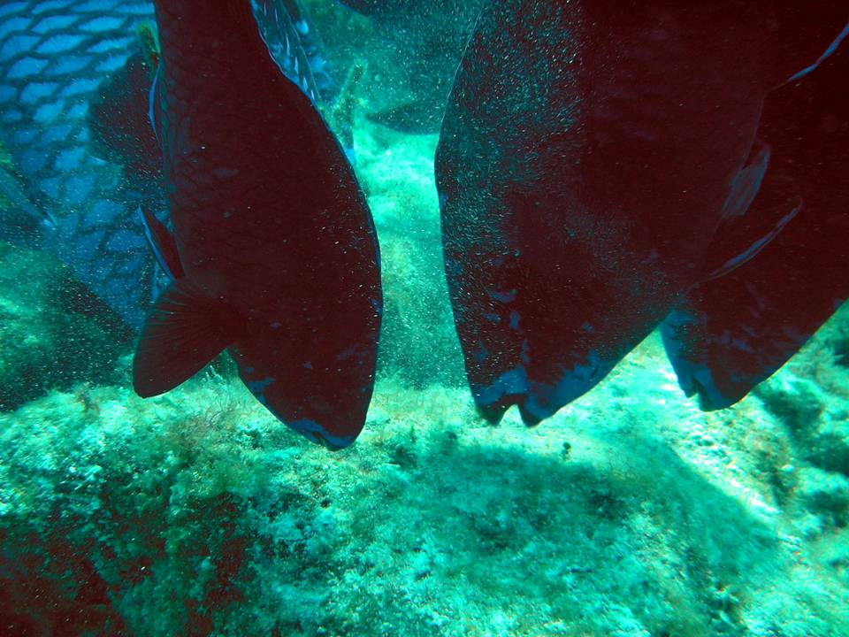
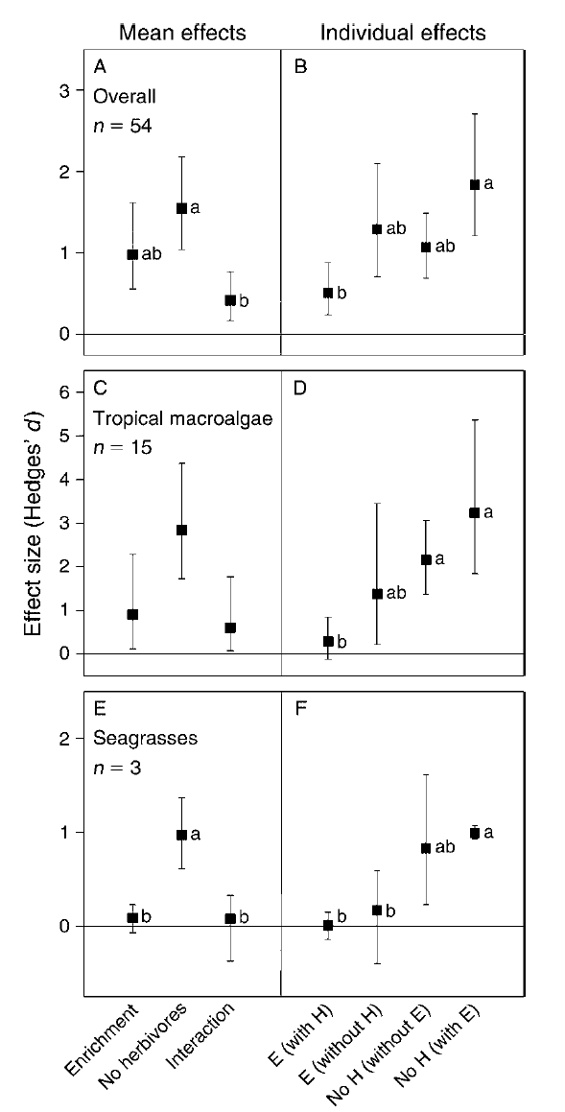
Herbivores Run Reefs!
Up to 90% primary production removed (Carpenter 1986, 1988)
Herbivore pressure greater check than nutrient availability (Burkepile and Hay 2006)
Herbivory facilitates coral recruitment, survivorship, and growth (e.g. Lewis 1986, Hughes et al. 2007, Burkepile and Hay 2008)
Burkepile and Hay
(2006) Ecology
Notes:
Our results are not much of a surprise to people that have been to a coral reef with healthy fish populations where you see big herbivores like this school of midnight parrotfish grazing seaweeds. This grazing is crucial for the health of coral reefs as it removes the majority of seaweeds and maintains open space for coral recruitment and growth.

Slide 4

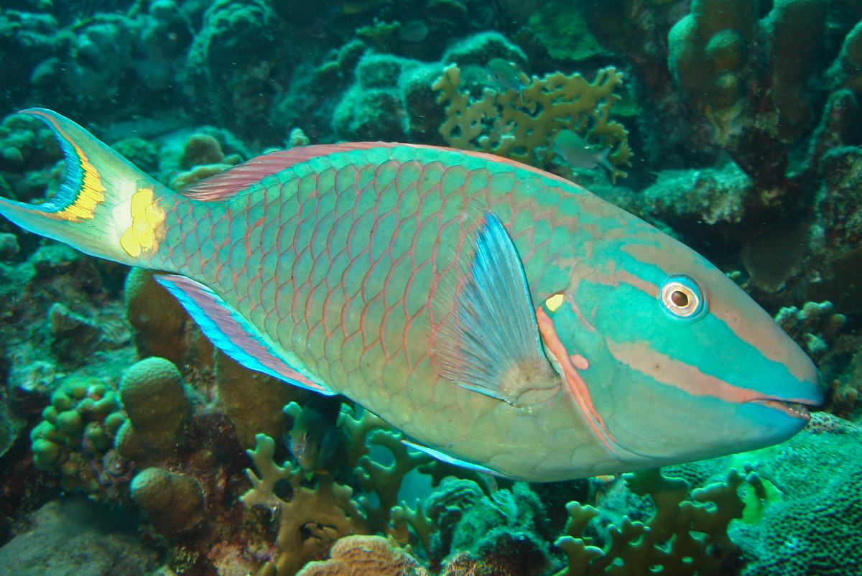

Everyone poops (and pees)
Algae
Sponges
Coral
Detritus
Nitrogen
Phosphorus
POM
Nitrogen

Slide 5
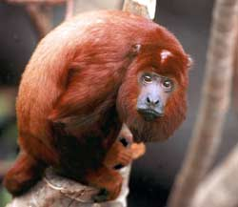
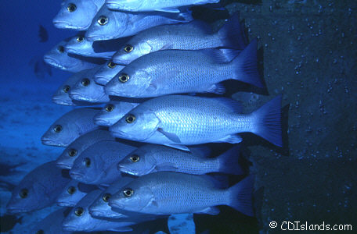
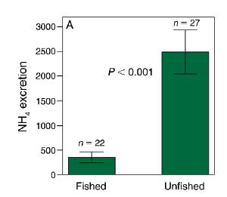
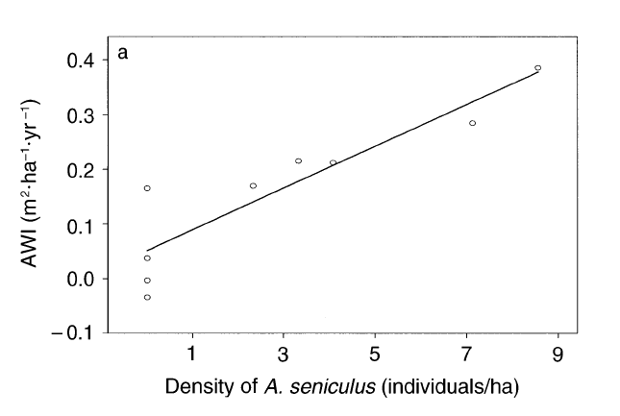
Consumer-driven nutrient cycling in nutrient poor ecosystems
Tropical Forests
Tropical Seagrass Beds
Gray
Snapper
Red
Howler
monkey
Feeley and Terborgh Ecology 2005
Layman et al. Eco Apps 2011

Slide 6
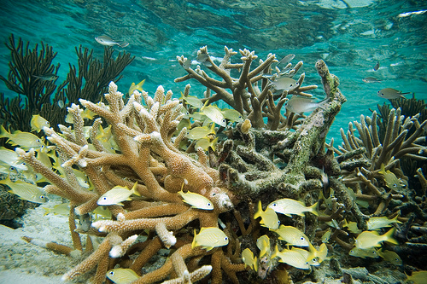
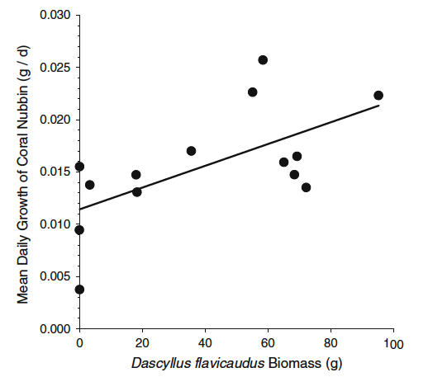
Fish Schools: An Asset to Corals
Resident grunts benefit Porites furcata and Acropora palmata
  25% more tissue N
  29% more zooxanthellae
  70% higher growth rates (Meyer et al. 1983, 1985)
Damselfish and Pocillopora
  Coral growth positively correlated with Dascyllus biomass
  Dascyllus important NH4 source (Holbrook et al. 2008)

Slide 7
Fish Schools as Nutrient Vectors
Goatfish
Mullidae
Snapper
Lutjanidae
Grunt
Haemulidae
Sources: Ogden and Ehrlich 1977, Helfman et al 1982,
Burke 1995, Nagelkerken et al. 2000, Nagelkerken et al. 2008

Slide 8
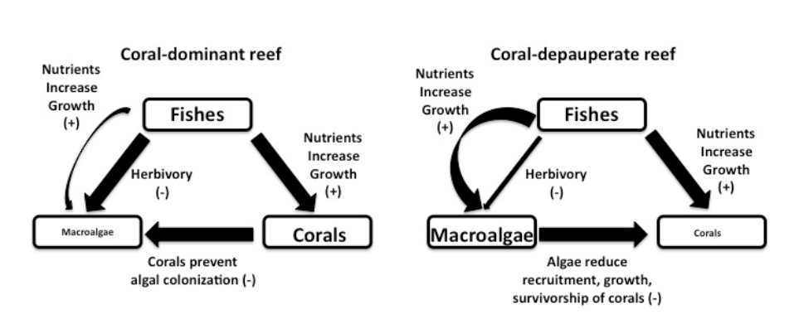
Context-dependent effects of fish excretion in reef systems

Slide 9
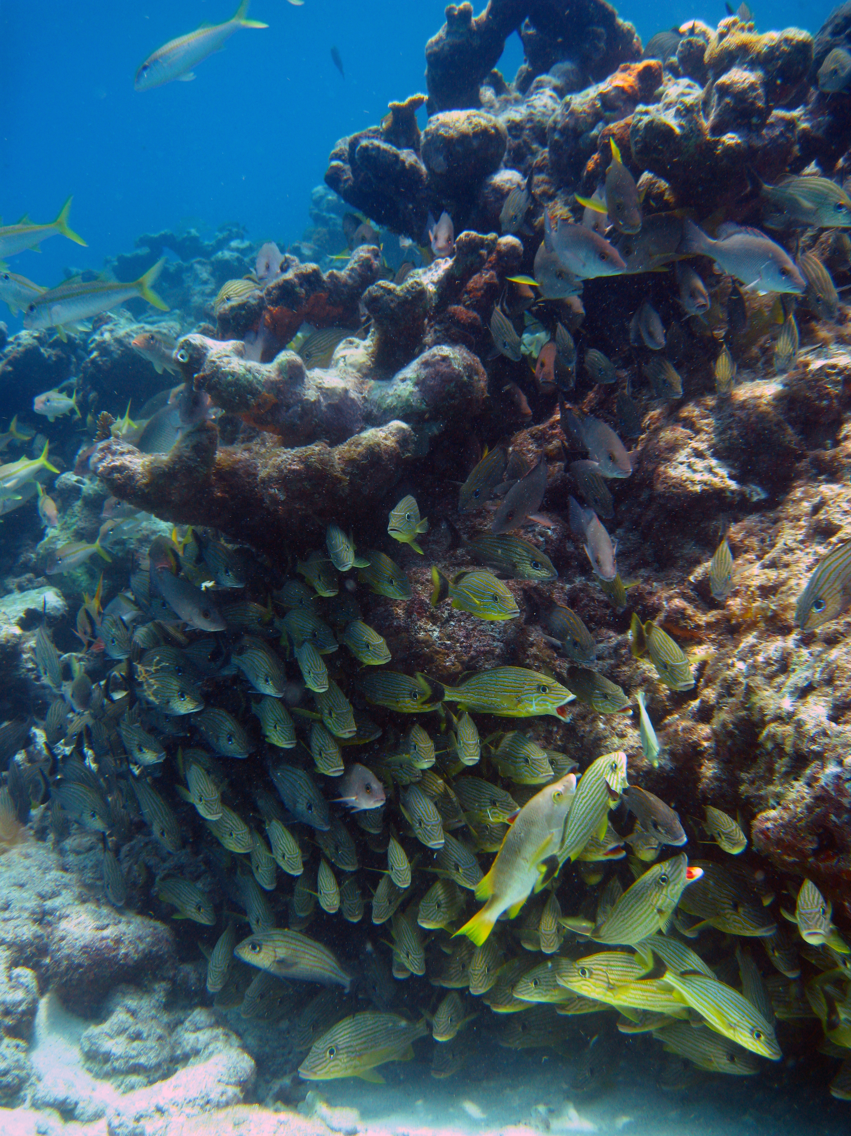
What happens to fish pee when corals are rare?
Dead
Acropora
palmata
Florida Keys coral cover <10%
Can abundant fishes facilitate algal abundance when coral cover is low?
Can they suppress coral recruitment and recovery?

Slide 10
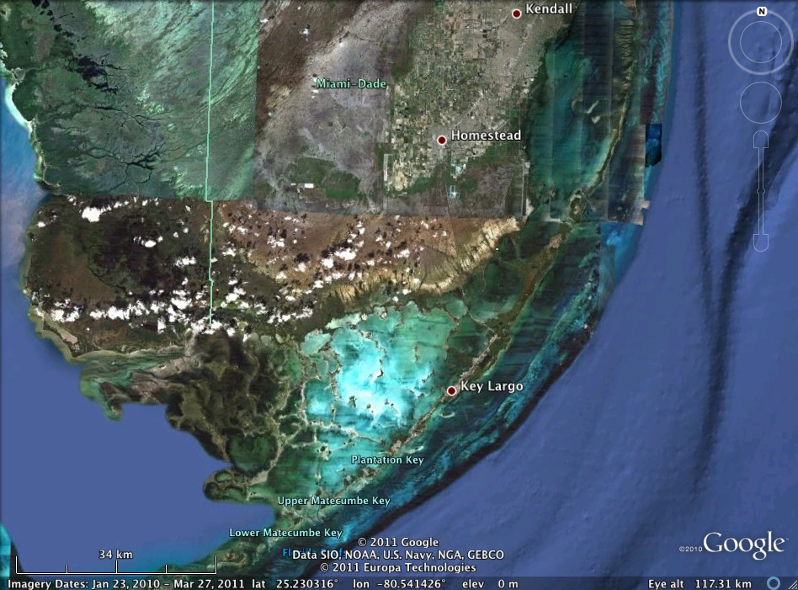
Fish Schools: an Asset to Corals?
Surveyed 12 forereefs (5-8m depth) across Upper Florida Keys
Quantified
  Fish community structure/biomass – 25X4m transects – no urchins (<0.01/m² since mass mortality)
  Benthic community structure – digital photographs
  Density of small corals (<5cm diameter) – is situ counts
  Algal C:N:P ratios – nutrient status of reefs

Slide 11
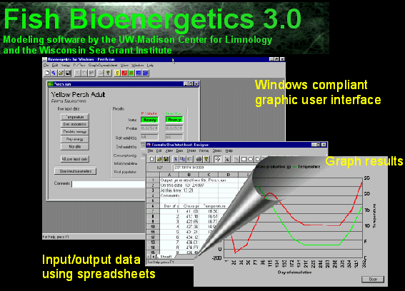
How much P (and N) do Fish Pee?
Bioenergetics modeling of excretion rates – freshwater fishes, reptiles, etc
Use fish biomass data to estimate fish contribution to nutrient availability - modeled at family level
Fish Bioenergetics 3.0 – Hanson et al. 1997
Model N and P excretion if you know:
  (1) Fish mass, (2) Fish stoichiometry, (3) Diet stoichiometry, (4) Assimilation efficiency, (5) Temperature

Slide 12
How much P (and N) do Fish Pee?
100g Parrotfish excretes 11mg N & 0.7mg P day⁻¹
100g Snapper excretes 54mg N & 16mg P day⁻¹
  Strong influence of diet quality on excretion quality
How good are the models? - empirical regressions for Gray Snapper (Layman et al. 2011)
100g Snapper excretes 50mg N & 14mg P day⁻¹

Slide 13
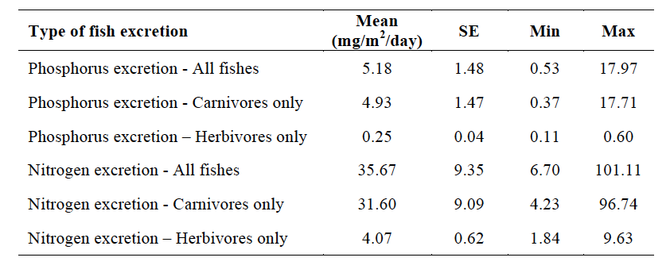
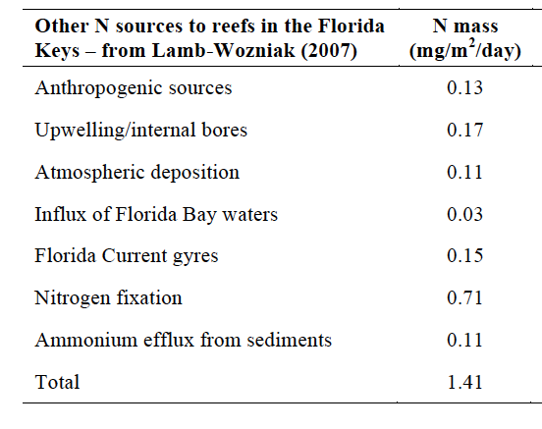
Fishes and N excretion
Fish largest source of N – 25X more N than all other sources combined
Spatially variable
Carnivores dominate signal

Slide 14
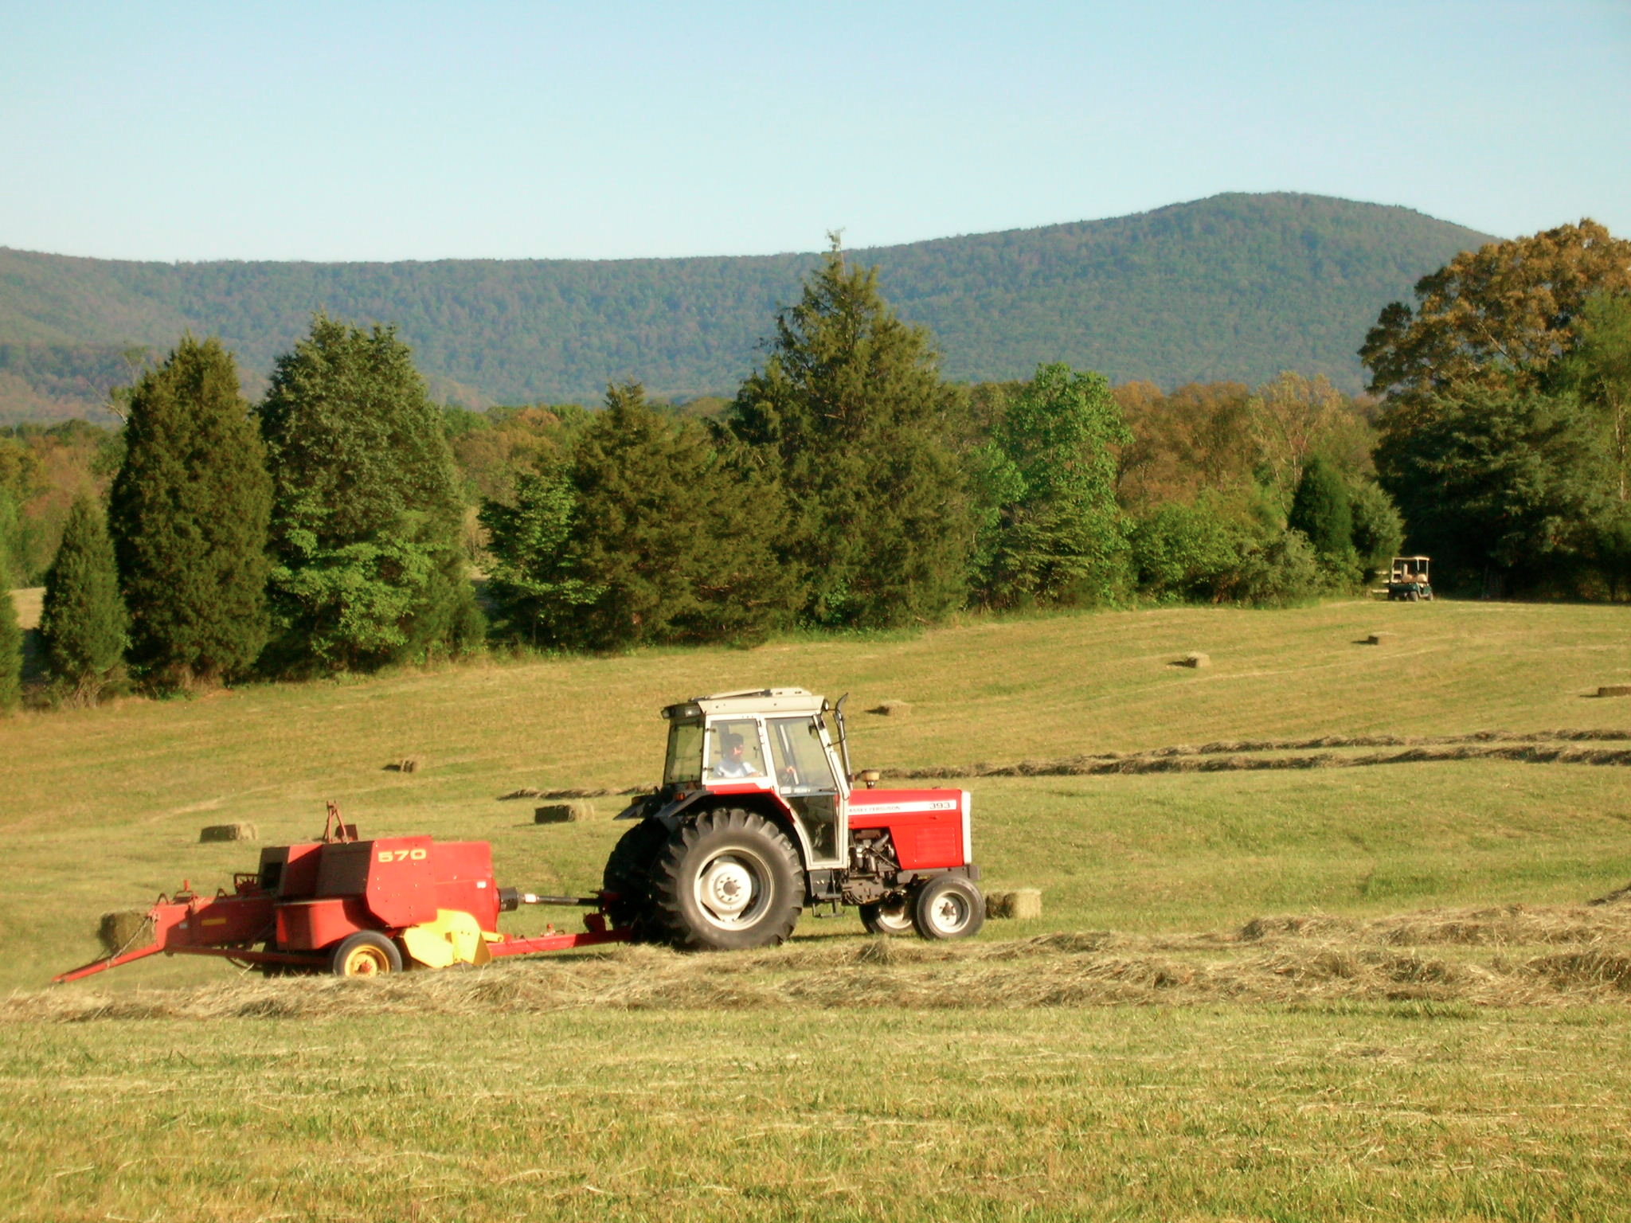
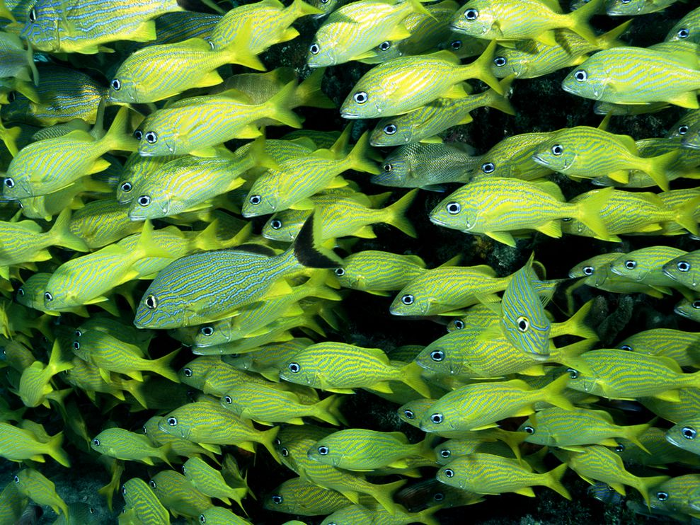
How Much Nitrogen is That?
Fescue Field
60g N per acre per year
7g N/m² per year
Coral Reef Fishes
Mean: 13g N/m² per year
Max: 33g N/m² per year

Slide 15
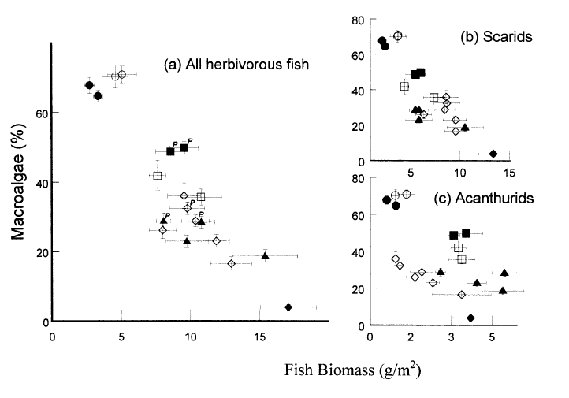
What Are Drivers of Algal Abundance?
Macroalgal abundance: 22-65% cover
Herbivore biomass – top-down
Fish N and P inputs –bottom-up
Coral cover
Territorial Damselfish abundance
Rugosity –more shelters for herbivorous fishes
Williams and Polunin
2001Coral Reefs

Slide 16
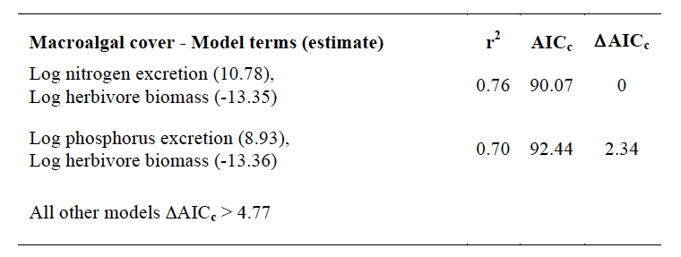
What Are Drivers of Algal Abundance?
Nutrient availability (positive) and herbivore biomass (negative) important correlates of algal abundance
Herbivore biomass alone poor predictor
Positive correlation algal %N & %P w/ fish excretion – fishes relieve nutrient limitation, stimulate production

Slide 17
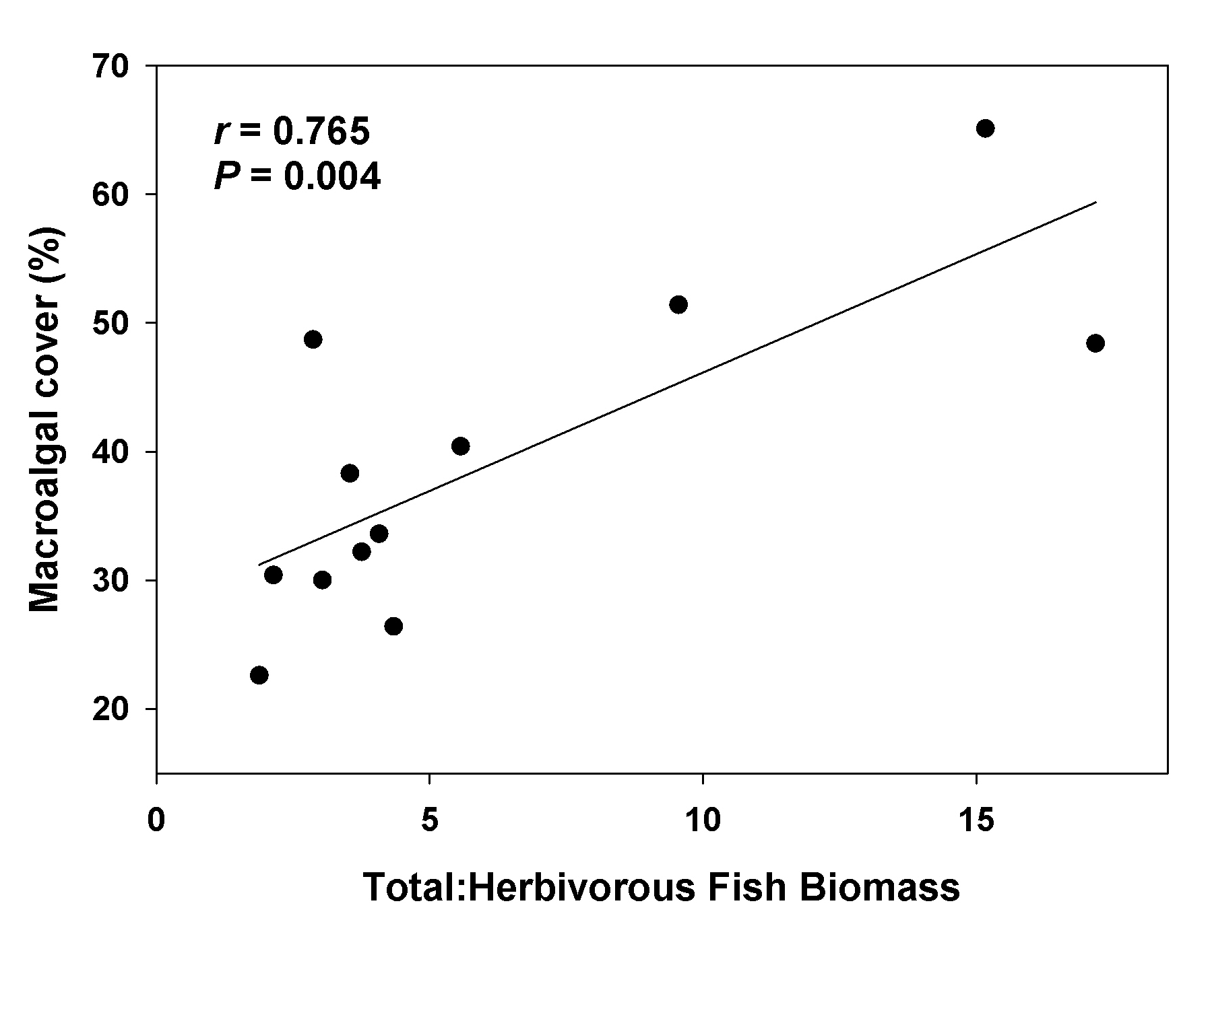
Interplay of Total/Herbivore Fish Biomass
Carnivores mostly grunts, snapper, goatfish – not predators on herbivores
Ratios vs. absolute values
Maitland Reef
11 g/m² herbivore biomass
31 g/m² total fish biomass
Conch Reef
66 g/m² herbivore biomass
271 g/m² total fish biomass
Production:Consumption

Slide 18
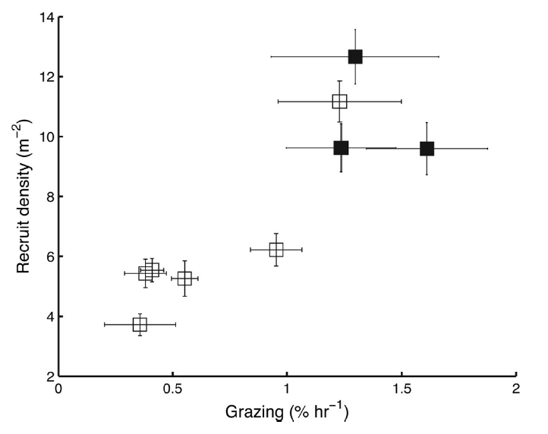
What Are Drivers of Juvenile Coral Density?
Range of juv. coral density: 4.1-9.3 indiv./m²
Potential Predictors:
  Herbivore mass
  Nutrient availability
  Coral cover
  Damselfish density
  Rugosity
  Corallivorous fish mass
Mumby et al. 2007 PNAS

Slide 19
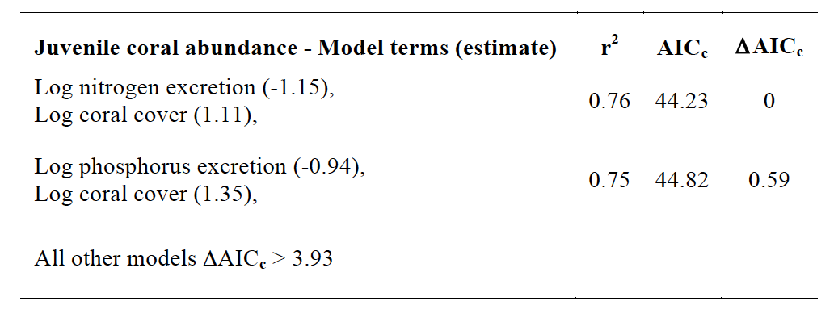
What are drivers of juvenile coral density?
Nutrient availability (negative) and coral cover (positive) best predictors
More coral cover = more source of coral larvae
Herbivore biomass explains little

Slide 20
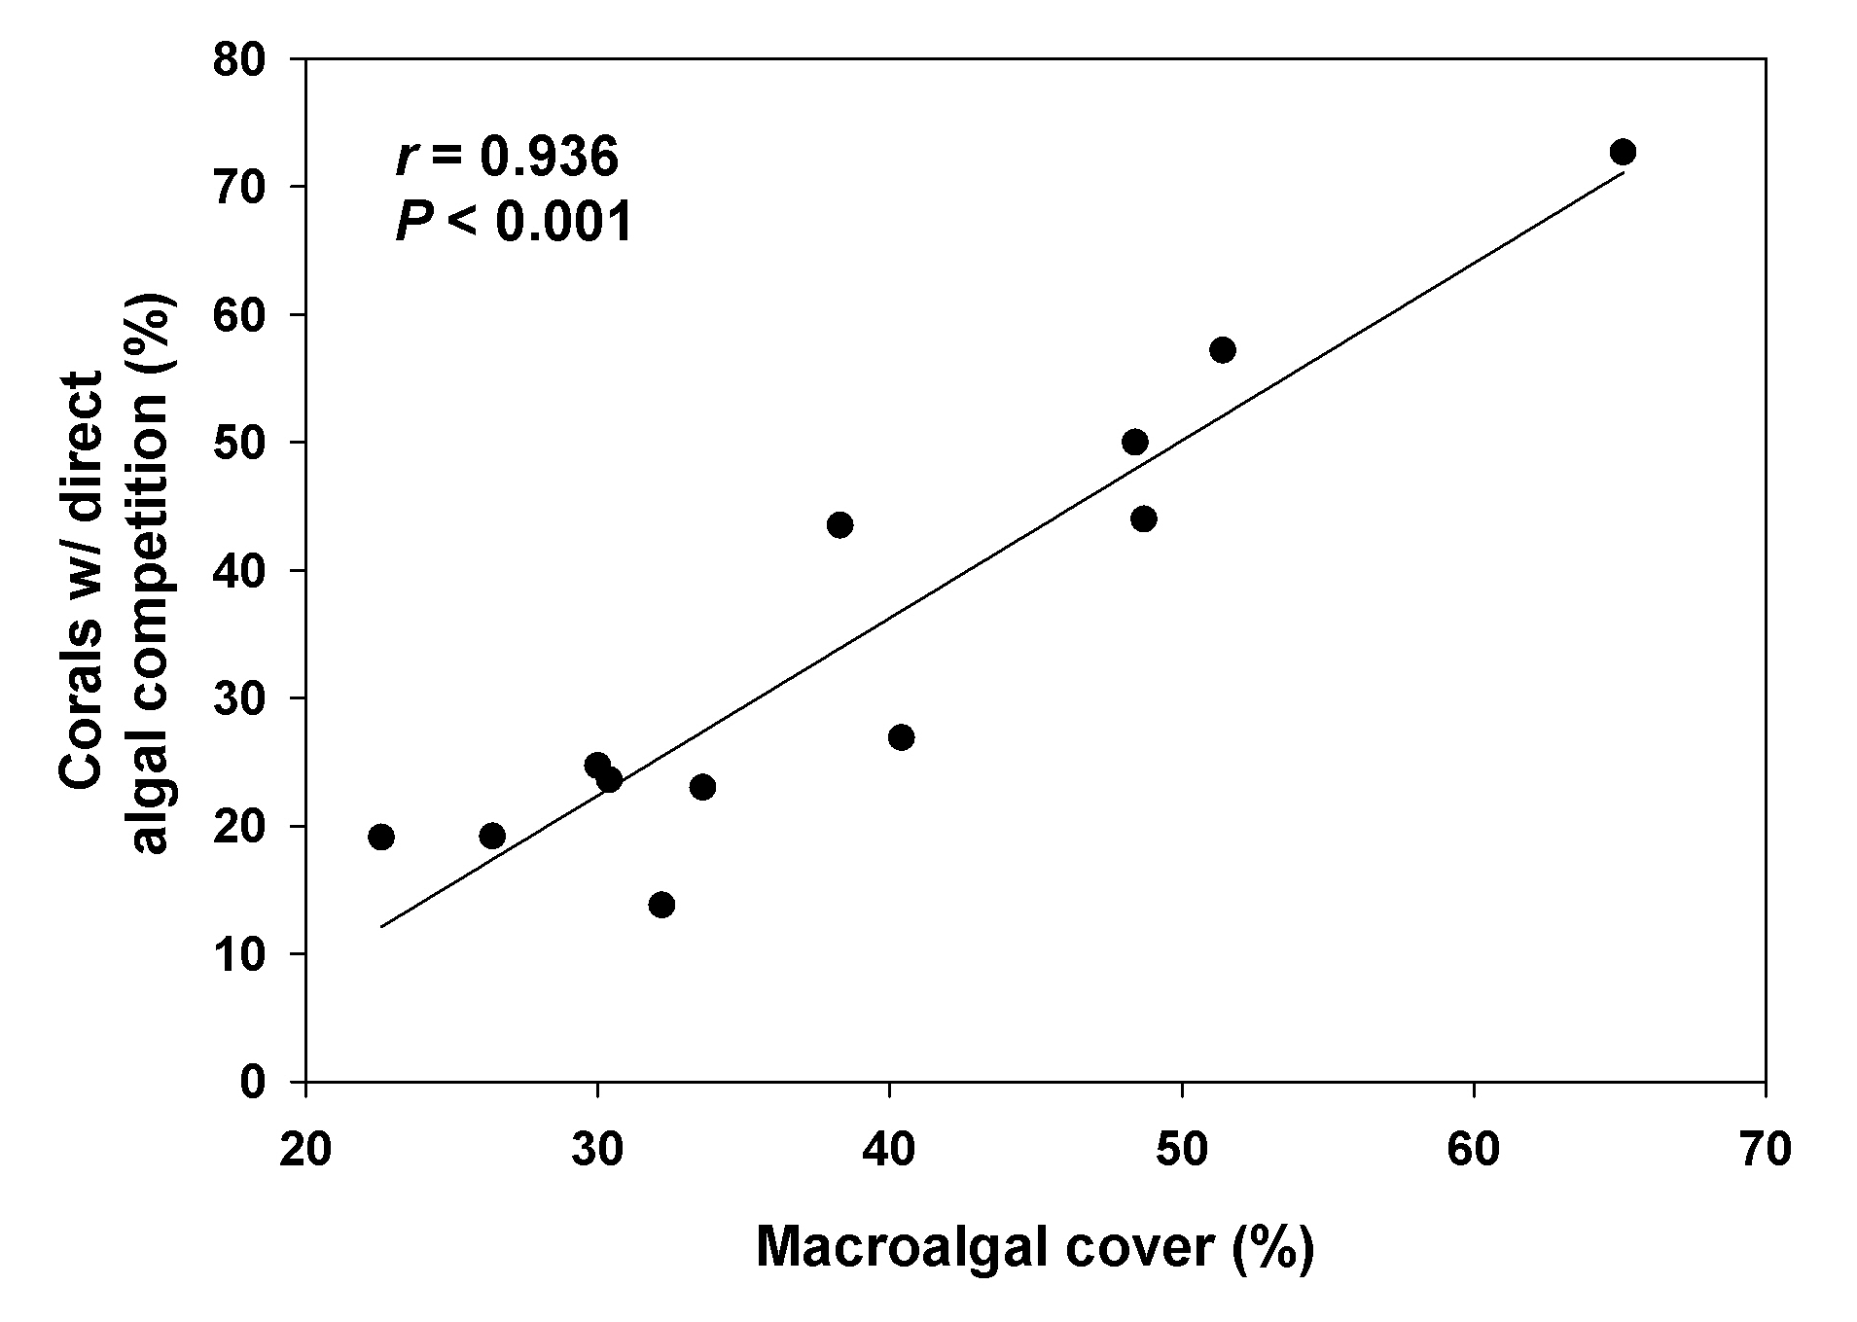
Why negative effect of fish nutrients on corals?
Facilitate algal abundance
  Increase coral-algal competition
  Reduce coral recruitment
  Lower coral fecundity
Decrease coral growth rates
Facilitate nasty microbes

Slide 21
Take Home
Florida Keys Pre-1980s
Florida Keys Today
Fish excretion can reinforce either algal-dominated or coral-dominated states depending on initial starting conditions of community

Slide 22
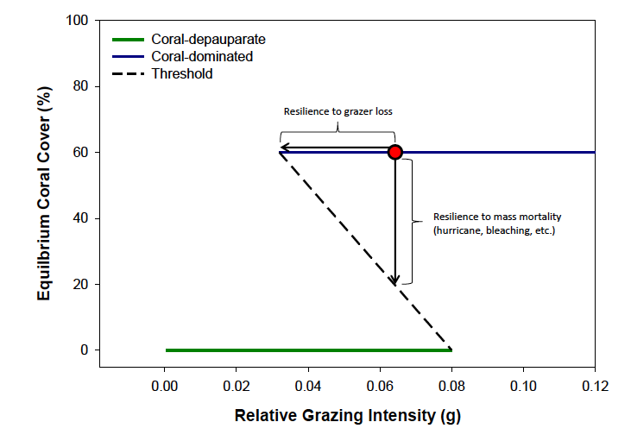
‘Rectal Transport’ and Phase Shifts on Reefs
Can nutrients supplied by fishes make reefs more susceptible to phase changes?
Resilience to grazer loss
Resilience to
disturbance
(hurricane, disease bleaching, etc.)
After Mumby
et al 2007 Nature

Slide 23
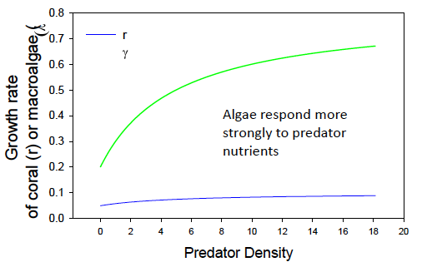
‘Rectal Transport’ and Phase Shifts on Reefs
What happens to reef communities when fish nutrients are included?
0.8
r
0.7
γ
0.6
0.5
Growth rate of
Coral (r) or macroalgae (γ)
0.4
Algae respond more
strongly to carnivore
nutrients
0.3
0.2
0.1
0.0
0
20
40
60
80
100
120
140
160
180
200
Carnivore Biomass (g/m²)
Heffernan et al In Prep

Slide 24
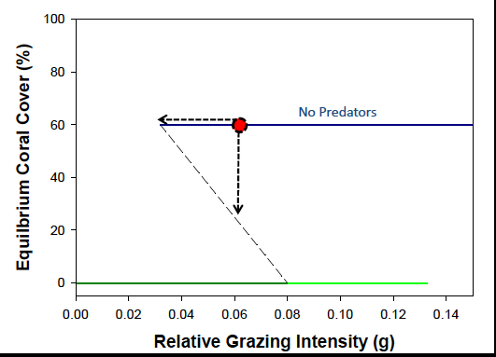
‘Rectal Transport’ and Phase Shifts on Reefs
Low Carnivore Biomass
Heffernan et al In Prep

Slide 25
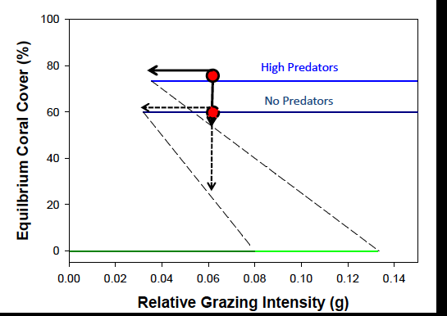
‘Rectal Transport’ and Phase Shifts on Reefs
High Carnivore Biomass
Low Carnivore Biomass
Heffernan et al In Prep

Slide 26
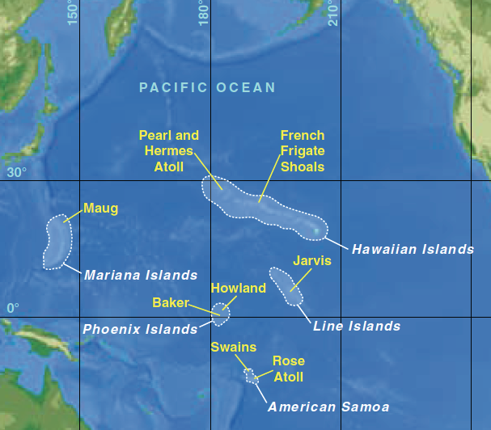
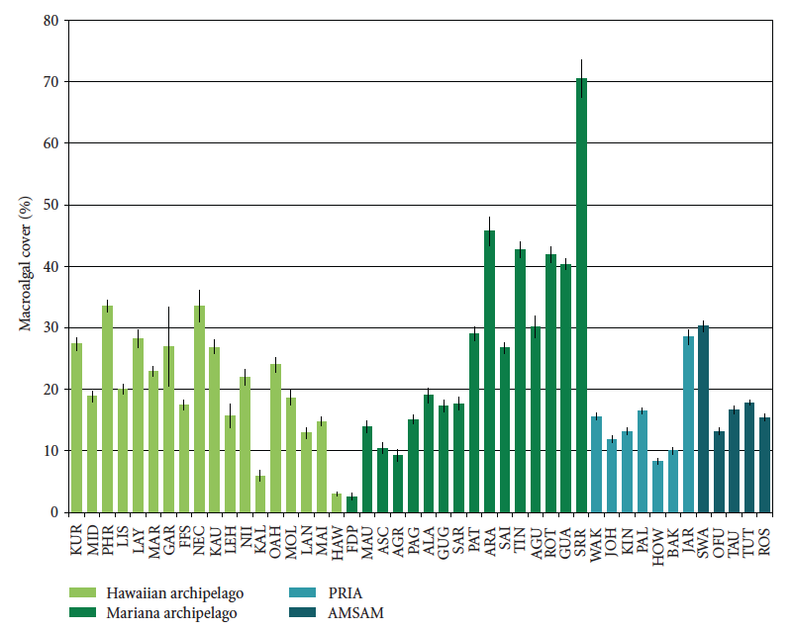
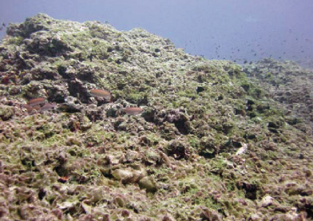
Role of Fish Nutrients in
“Healthy” Reef Systems
Algae-dominated reefs - Vroom 2006, 2011

Slide 27
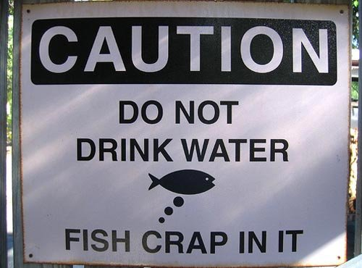
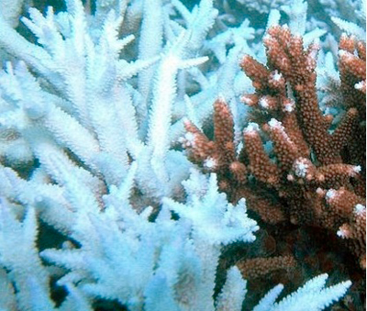
Fish Pee In a Warming World
MPAs: Rebuild fisheries and trophic linkages – best conservation tool at our disposal
Also increase nutrient loading on reefs via fishes
MPAs don’t protect against coral bleaching
Could MPAs reinforce coral loss as bleaching and ocean acidification increase?
Coral
Bleaching

Slide 28

‘Rectal Transport’ on Reefs - Moving Forward
Primary production – spatial/temporal impacts of fish schools on nutrient co-limitation
Benthic-pelagic coupling - Growth/survivorship/reproduction of corals and sponges
  Acropora cervicornis restoration
Coral microbiology – impact of nutrient subsidies on coral-associated bacteria and coral health
Fish growth rates – growth of small reef-associated fishes e.g. damselfishes, surgeonfishes

Slide 29



Funding and Acknowledgments
“I don’t drink water – fish pee in it”
W.C. Fields
Florida Keys National Marine Sanctuary – Joanne Delany, Scott Donahue
Ben Ruttenberg, Fourqurean Lab. Andrew Thurber, Megan Kelley, Sergio Burgos, Melissa Pimentel, Gary Gross
National Science Foundation, FIU Faculty Development Grant, FIU Arts & Sciences
“Fishing Down Nutrients: Altering Coral Reef Ecosystems From the Bottom Up”
Jacob Allgeier, Craig Layman,
Peter Mumby, Amy Rosemond
4:45PM - 13B The Changing Role of Fishes in Coral Reef Ecosystems
© Taro Gomi

